Slide 1
Task-3
Test Website: testasp.vulnweb.com
Name: Shreyansh Shital Patil

Slide 2
Vulnerability -> Boolean Based SQL Injection Severity -> Critical
Effect -> This Can lead to some other hacker executing instructions that can lead to Reading, updating and deleting arbitrary data/tables from the database.
Steps to reproduce -> Vulnerability as found by Netsparker Solution ->
Using a Data Access Layer(DAL) if not already or using Object Relational Mapping (ORM).
Locate all dynamically generated SQL queries and convert them to parameterized queries.
Use weblogs and application logs to see if there were any previous undetected attacks.

Slide 3
2. Vulnerability -> Out of Band SQL Injection Severity -> Critical
Effect -> This Can lead to some other hacker executing instructions that can lead to Reading, updating and deleting arbitrary data/tables from the database.
Steps to reproduce -> Vulnerability as found by Netsparker Solution ->
Using a Data Access Layer(DAL) if not already or using Object Relational Mapping (ORM).
Locate all dynamically generated SQL queries and convert them to parameterized queries.
Use weblogs and application logs to see if there were any previous undetected attacks.

Slide 4
3. Vulnerability -> Cross-Site Scripting
Effect -> Allows scripts to run through the search bar.
Steps to reproduce ->
Go to the website “testasp.vulnweb.com”
You will find the search option in the top menu
After clicking it you will be directed to the page with a search box
Enter a query in the search , for example <script>alert(1)</script>
Clicking on the search button we find an alert of 1 being displayed as in the above case.
If used with several XSS payloads and tested on the burp suite a lot more amount of damage may be caused.
Solution ->
Filter the search input such that only valid input is searched whereas the scripts are ignored.
Encode data on output.
Use appropriate response headers.
Use Content security policy.

Slide 5
4. Vulnerability -> Website creation tools are visible
Effect -> After knowing the tools used to create a particular website only particular and appropriate tools can be selected making it easy to exploit a website. Steps to Reproduce ->
Visit the “https://builtwith.com/” website.
In the lookup box type the name of the website
Press the lookup button and we get the tools used to develop the website

Slide 6
5. Vulnerability -> Details such as OS and open port detected
Effect -> open ports may lead to system attacks bypassing the firewall Steps to Reproduce ->
Open a Linux terminal
Type “nmap -A testasp.vulnweb.com” in the terminal
This gives the related information in the terminal
Screenshots and files are attached to the document below

Slide 7
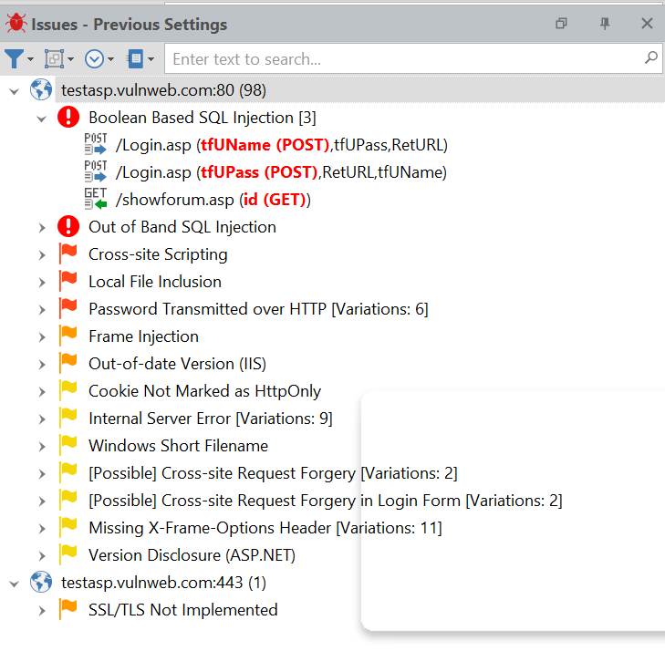
NetSparker Vulnerabilities

Slide 8
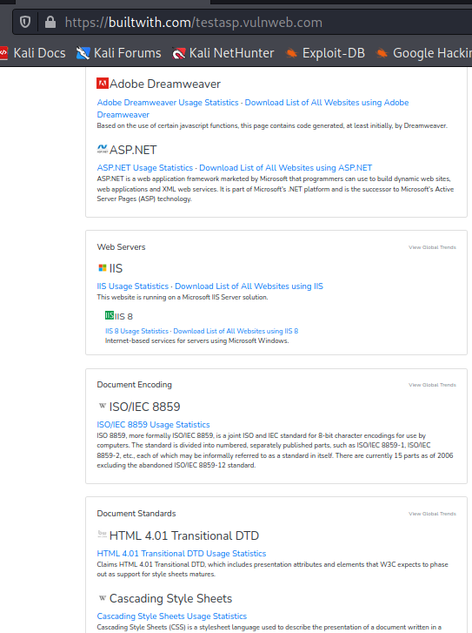
BUILT WITH SCREENSHOT

Slide 9
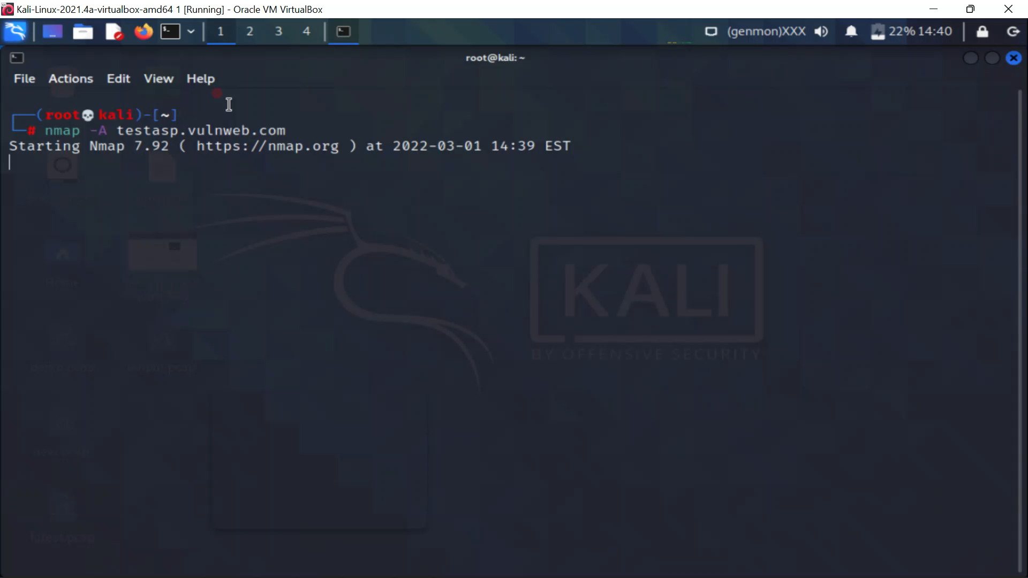
Open port and OS vulnerabilty

Slide 10
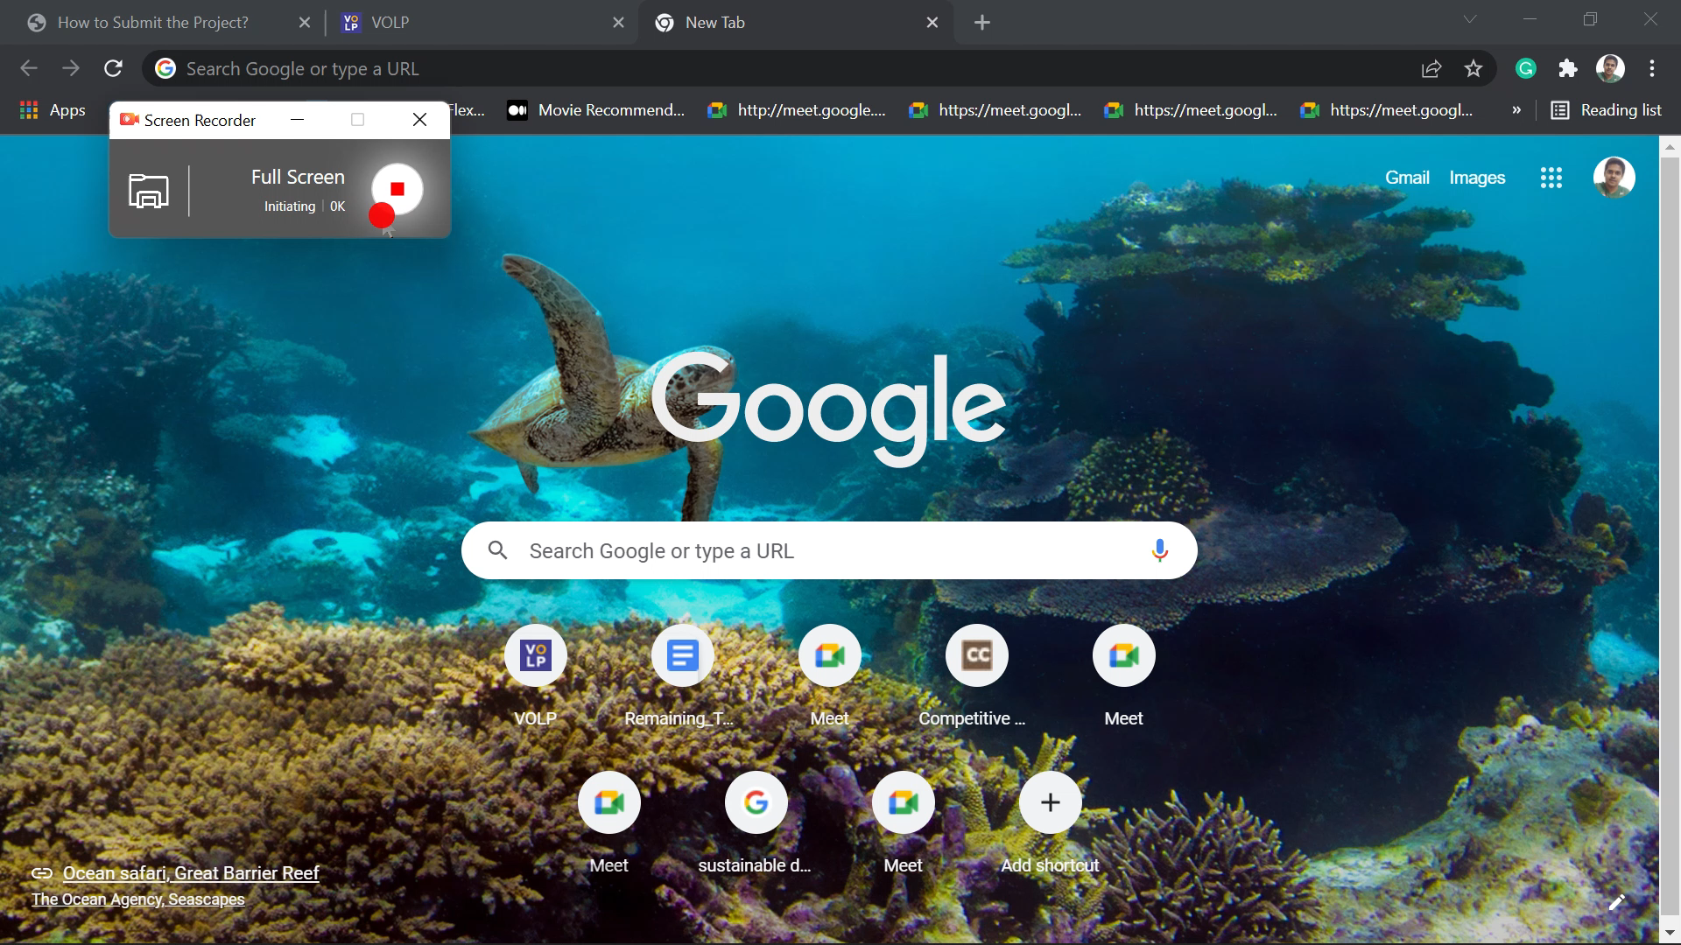
XSS vulnerability demo

